Slide 1

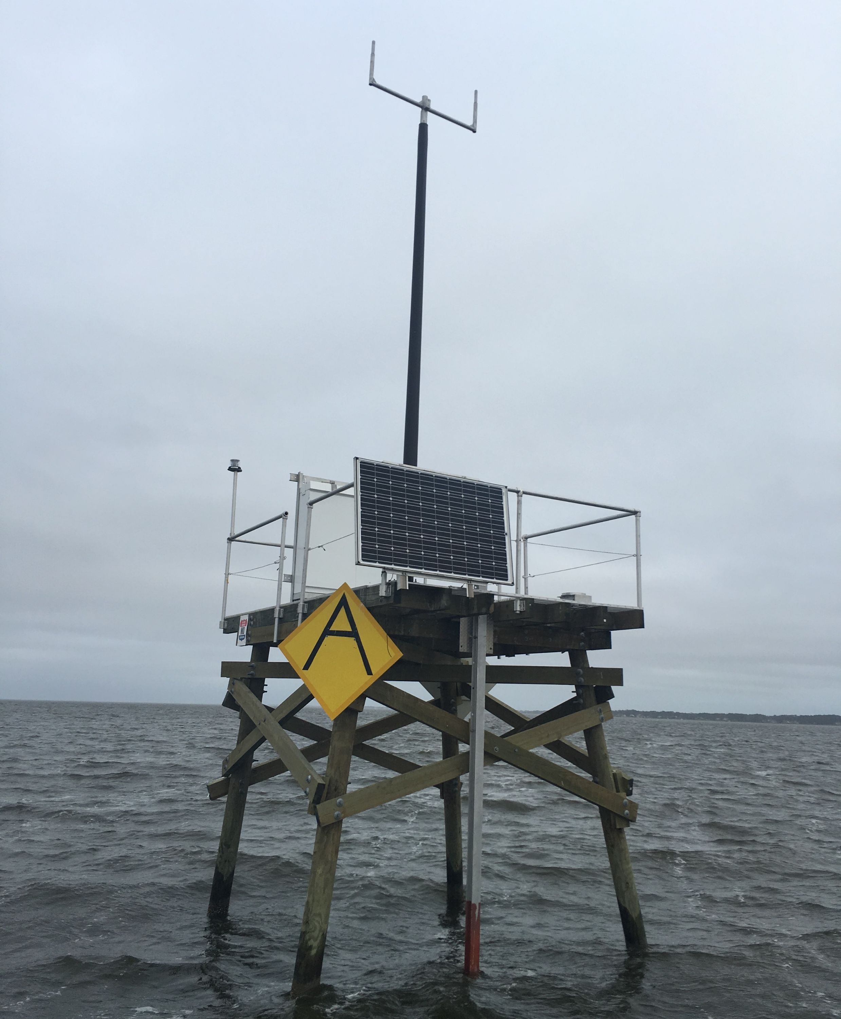
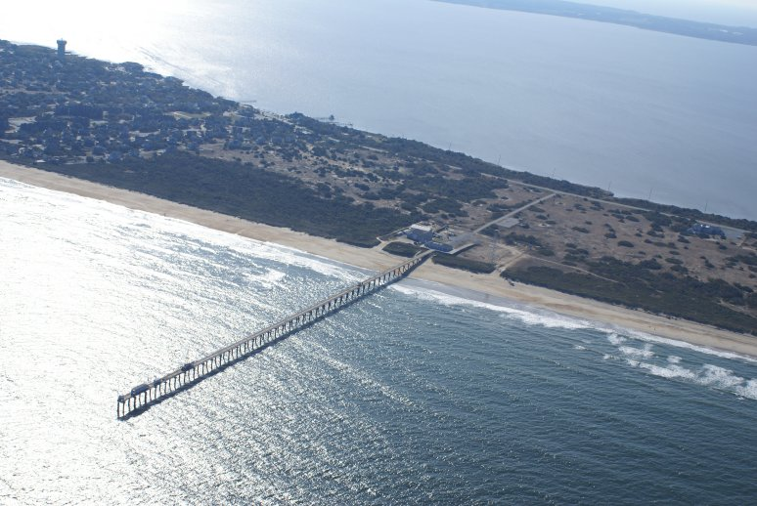
https://twitter.com/Rainmaker1973/status/979697624302411776
Bridging MongoDB to PostGres
A Data Analysis and Migration Project
Paul Schrum, NC State MGIST ptschrum@ncsu.edu 30 March 2018
Background
The US Army Corps of Engineers' Field Research Facility in Duck, North Carolina (FRF), maintains multiple sensor stations in the Atlantic Ocean and the Currituck Sound. To keep track of important information about these sensors, FRF maintains a database with all essential information about stations, sensors, and service times in a MongoDB database.
Methods
The data dump from MongoDB is a text file in which every line is a single JavaScript Object Notation (JSON) entity, and each JSON entity represents one MongoDB document. Step 1 was to analyze the JSON data and determine how to represent this data in an RDBMS. Analysis revealed the following Entity Relationship Diagram.
The second step was to implement the bridge, which is Python code using arcpy to read the text file, parse the data, and write the values to the PostGres database such that it fits the ER Diagram, including storing of the spatial coordinates so that the points may displayed on a web map.
The third step is to implement the bridge in Python code. This module will read the MongoDB data dump, convert it to SQL, and update the three tables (see Diagram 1) as needed.
A web map of the region was created, and the web application was created for the same area. Widgets were added allowing FRF personnel to upload new data to the existing database. They may still query their data using SQL if they like. Other map-oriented queries were provided.
The Problem
The Field Research Facility has a database of all their stations and the sensors on those stations, including active/inactive dates and times. The database is implemented as Document Database (MongoDB), which is a relatively new database technology. Importantly, performing queries on Document Databases requires new skillsets. FRF staff would like to have the data available for running queries using the Structured Query Language (SQL).
The Solution
To provide FRF personnel with the ability to query their data using SQL, the data must be stored in a Relational Database Management System (RDBMS) such as PostGres. To accomplish this, the data must be migrated from MongoDB to a PostGres RDBMS. This project accomplishes this migration.
The Challenge
Migrating the data from MongoDB to PostGres is a challenging process because the data configuration of a Document Database is fundamentally different from the "data shape" of a RDBMS. The first challenge was to analyze the data exported from MongoDB and determine what should be the appropriate Entity Relation Diagram for the RDBMS.
fc_stations
----------------------
StationName (pk)
Lat
Long
projectName
waterDepth
tbl_gages
----------------------
gageId (pk)
gageModelName
StationName (fk)
assigned
comments
createdAt
title
1
tbl_statuses
------------------
statusId (pk)
gageId (fk)
status
startTime
endTime
updatedAt
updatedBy
1
∞
∞
Diagram 1: Entity Relation Diagram for the RDMBS implementation of the database.
Figure 2: Photograph of the a typical gage station in the Currituck Sound.
Discussion
Discussion Section goes here.
Future work will include adding the sensor reading data to the database.
Results
Results have yet to be determined. The Python code and the web maps are still under development as of 3/30/2018.
Conclusion
That's, that's, that's,
That's all folks.
Acknowledgements
Thanks to the Field Research Facility staff for their assistance with this project. All photographs are provided by the Field Research Facility except for the background image, which is public domain.
Figure 1: Photograph of the Field Research Facility in Duck, North Carolina.

